Slide 1
DTS207TC Database Development and Design
Lecture 9
Chap 13. Data Storage Structure
Di Zhang, Autumn 2025
Titles with * will not be assessed
Notes:
I am very happy to have the opportunity to meet with you all in this course.

Slide 2
Outline
Database vs. File system*
File Organization
Organization of Records
Cache
Column-Oriented Storage*

Slide 3
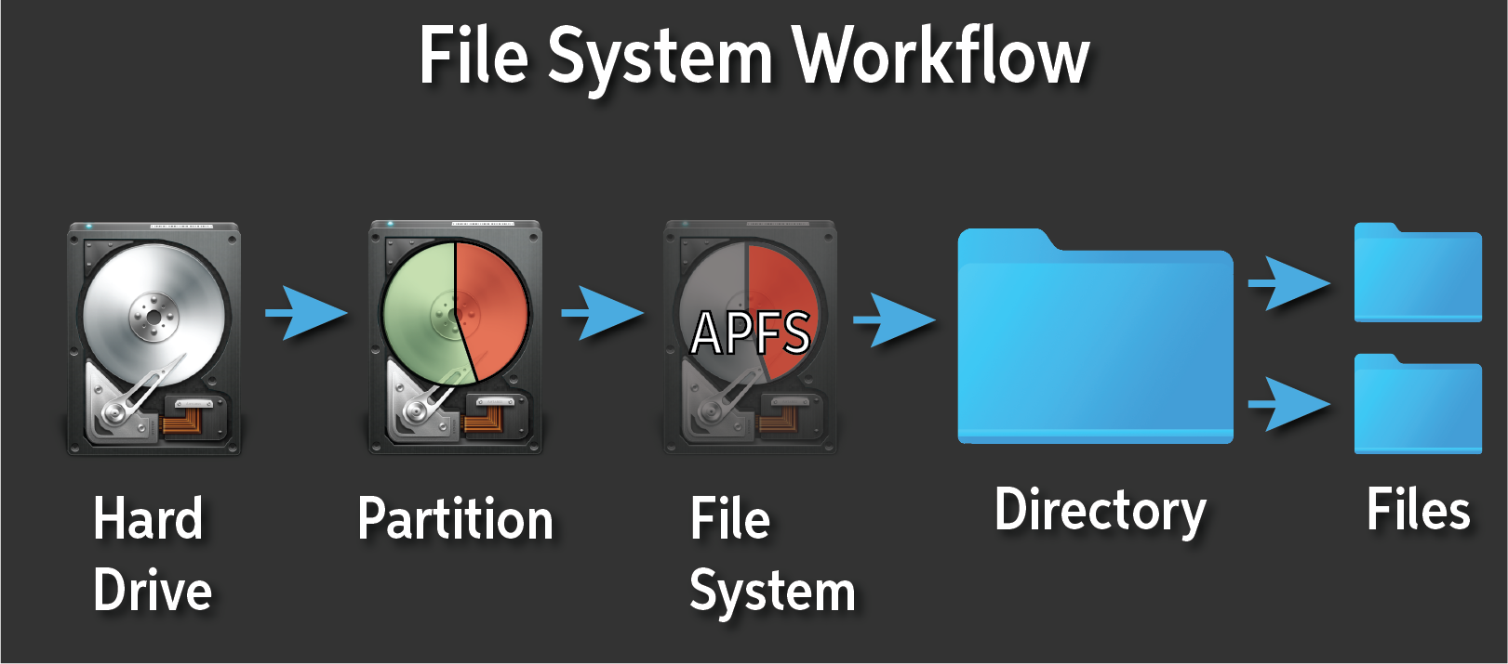
What is a File System?
The Translator Between You and Your Storage
The Core Problem:
  A storage device (HDD, SSD) is just a "dumb" collection of fixed-size blocks.
  How do we store, find, and manage our data (documents, photos, code) in a user-friendly way?
The Solution: The File System
  It is the software layer in an operating system that manages how data is stored, organized, and retrieved on a storage device.

Slide 4
What It Provides:
Abstraction & Structure | Core Functions
Files: Named collections of data (bytes). | Naming: Creates a human-readable name for data.
Directories/Folders: Hierarchical organization. | Metadata: Tracks info like size, creation time, permissions.
Pathnames: A logical address (/home/doc/report.txt). | Access Control: Manages who can read/write files.
 | Reliability: Prevents corruption (e.g., journaling).

Slide 5

The Magic Trick: Mapping
The file system's key job is to translate the logical structure (Files & Folders) into the physical reality (Blocks on a disk).
In a Nutshell: A File System turns a chaotic pile of raw storage blocks into an organized, usable, and reliable digital filing cabinet.
[User/App sees: "/Projects/data.txt"]
↓
[File System maps this to:]
- Block 1023: "Hello, "
- Block 1045: "World!"
- Block 2011: (Rest of file...)

Slide 6
Database Systems vs. File Systems: A Layered Partnership
File Systems: Presents a linear array of bytes within each file.
Database System: as the "Data Expert"
  Abstraction: Presents tables, indexes, schemas, and a high-level query language (e.g., SQL).
Key Responsibilities:
  Data Structures: Implements tables, B+Trees, and indexes within one or more files provided by the file system.
  Query Processing: Translates high-level queries into low-level file operations (read, write, seek).
  Advanced Control: Implements its own buffer pool caching and transaction logs for reliability and performance.

Slide 7
The Crucial Relationship
A Database System is a sophisticated user of the File System.
The File System provides the foundation of persistent storage, while the Database System adds the logic for data organization, integrity, and access.
[Database Engine (SQL, Transactions, Query Optimizer)]
↓ (Uses)
[File System API (open, read, write, seek)]
↓ (Manages)
[Raw Disk Blocks (Hard Drive / SSD)]

Slide 8
How Programs Control Data Layout Within Files
Key Distinction: Logical vs. Physical
  Logical Layout: The order and position of bytes as seen by the application. This is what a program controls.
  Physical Storage: The location of data on the actual disk hardware. This is managed automatically by the OS and File System.
Core Mechanism: The File Pointer
  Every open file has a file pointer (or file offset), which acts as a cursor within the file.
  Read/Write operations start at the current position of this pointer and advance it automatically.
Primary Control Method: Seeking
  The lseek (Linux/POSIX) or SetFilePointer (Windows) system call is the primary tool.
  It allows a program to reposition the file pointer to any byte offset within the file.
// 1. Open a file
int fd = open("data.bin", O_RDWR);
// 2. CONTROL: Move pointer to a specific location (e.g., 1024 bytes from start)
lseek(fd, 1024, SEEK_SET);
// 3. Write data at that exact location
write(fd, buffer, buffer_size);
// The data "buffer" is now logically placed at offset 1024-1024+buffer_size.

Slide 9

The Abstraction of Storage
The Hardware Reality: Disk Sectors
Definition: The smallest physically addressable unit on a storage device.
Typical Size:
  Legacy HDDs: 512 Bytes
  Modern HDDs/SSDs: 4096 Bytes (4KB) - "Advanced Format"
Analogy: The individual bricks used in construction.
The Software Abstraction: File System Blocks
Definition: The smallest unit of allocation managed by the file system.
Typical Size: 4KB (most common), 8KB.
Why? Efficiency. Managing 4KB blocks is far less overhead than managing 512B sectors.
Analogy: Pre-assembled wall panels made from multiple bricks.

Slide 10
The Crucial Relationship: The Block-to-Sector Map
A single File System Block spans multiple contiguous Disk Sectors, or one big sector.
File System View: [ Block 0 (4KB) ][ Block 1 (4KB) ]
| | | |
Disk View: [Sector A][Sector B]...[Sector H] [Sector I][Sector J]...
(512B Sectors) (8 Sectors per Block) (8 Sectors per Block)
// OR with Modern 4K Sectors
File System View: [ Block 0 (4KB) ][ Block 1 (4KB) ]
| | | |
Disk View: [ Sector A (4KB) ][ Sector B (4KB) ]
(1 Sector per Block) (1 Sector per Block)

Slide 11
File Organization
The database is stored as a collection of files. Each file is a sequence of records. A record is a sequence of fields.
One approach
  Assume record size is fixed
  Each file has records of one particular type only
  Different files are used for different relations
  This case is easiest to implement; will consider variable length records later
We assume that records are smaller than a disk block
  .

Slide 12
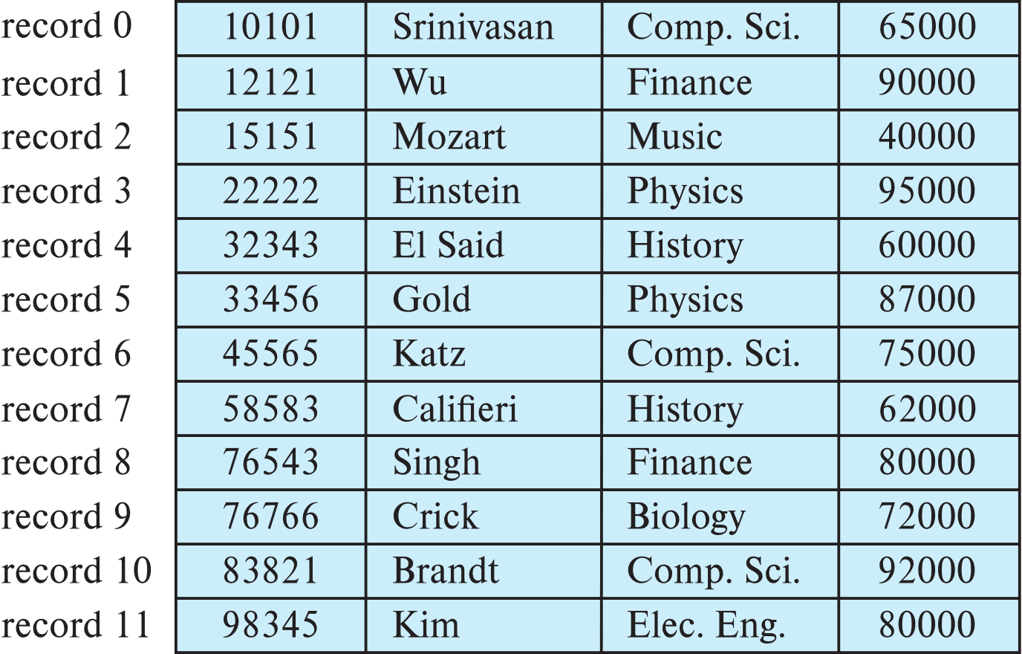
Fixed-Length Records
Simple approach:
  Store record i starting from byte n ∗ (i – 1), where n is the size of each record.
  Record access is simple but records may cross blocks
    Modification: do not allow records to cross block boundaries

Slide 13
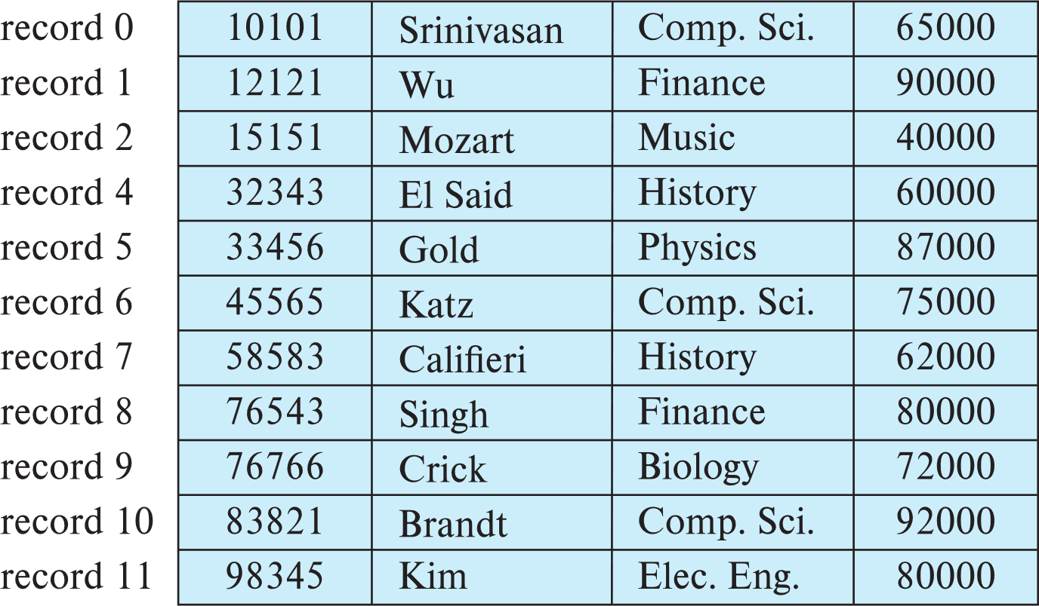
Fixed-Length Records
Deletion of record i: alternatives:
  move records i + 1, . . ., n to i, . . . , n – 1
  move record n to i
  do not move records, but link all free records on a free list
  Record 3 deleted

Slide 14
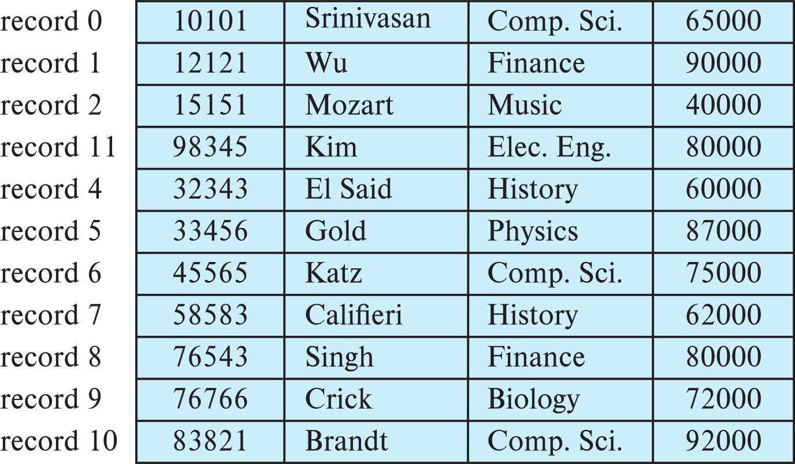
Fixed-Length Records
Deletion of record i: alternatives:
  move records i + 1, . . ., n to i, . . . , n – 1
  move record n to i
  do not move records, but link all free records on a free list
  Record 3 deleted and replaced by record 11

Slide 15
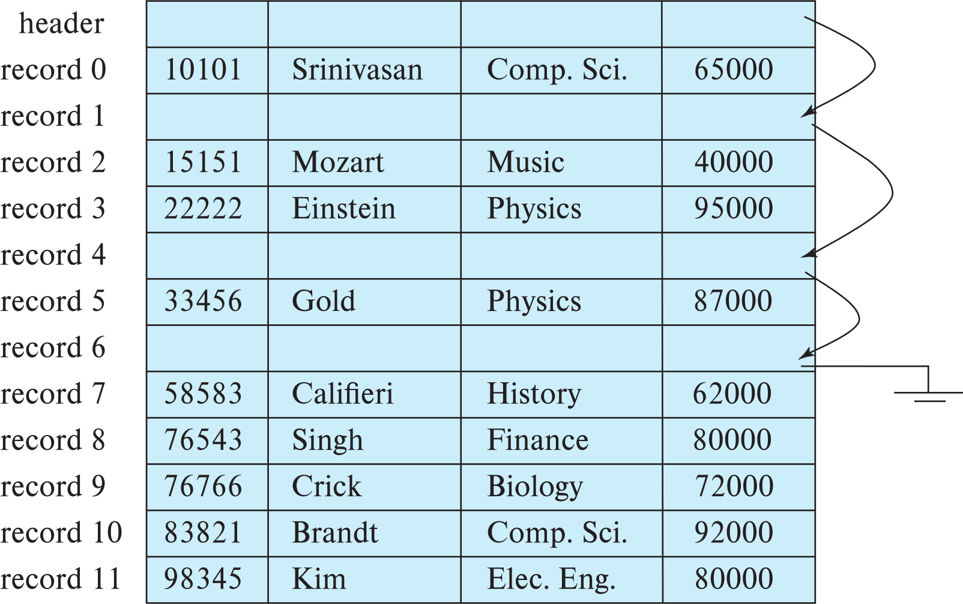
Fixed-Length Records
Deletion of record i: alternatives:
  move records i + 1, . . ., n to i, . . . , n – 1
  move record n to i
  do not move records, but link all free records on a free list

Slide 16
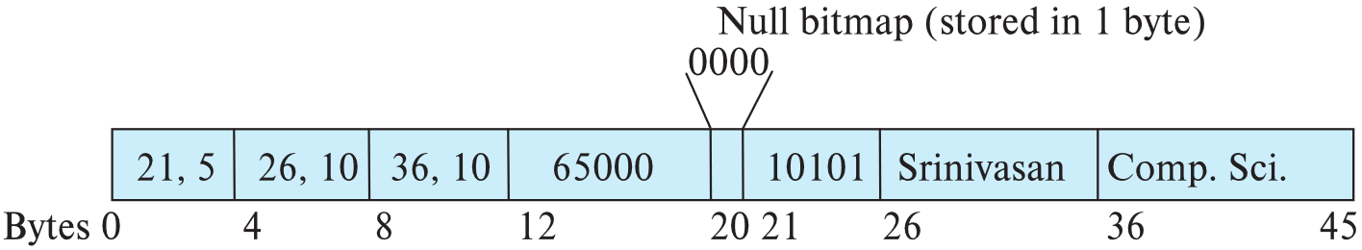
Variable-Length Records
Variable-length records arise in database systems in several ways:
  Storage of multiple record types in a file.
  Record types that allow variable lengths for one or more fields such as strings (varchar)
  Record types that allow repeating fields (used in some older data models).
Attributes are stored in order
Variable length attributes represented by fixed size (offset, length), with actual data stored after all fixed length attributes
Null values represented by null-value bitmap

Slide 17
Variable-Length Records: Slotted Page Structure
Slotted page header contains:
  number of record entries
  end of free space in the block
  location and size of each record
Records can be moved around within a page to keep them contiguous with no empty space between them; entry in the header must be updated.
Pointers should not point directly to record — instead they should point to the entry for the record in header.

Slide 18
Storing Large Objects
E.g., blob/clob types
Records must be smaller than pages
Alternatives:
  Store as files in file systems
  Store as files managed by database
  Break into pieces and store in multiple tuples in separate relation
    PostgreSQL TOAST

Slide 19
Organization of Records in Files
Heap – record can be placed anywhere in the file where there is space
Sequential – store records in sequential order, based on the value of the search key of each record

Slide 20
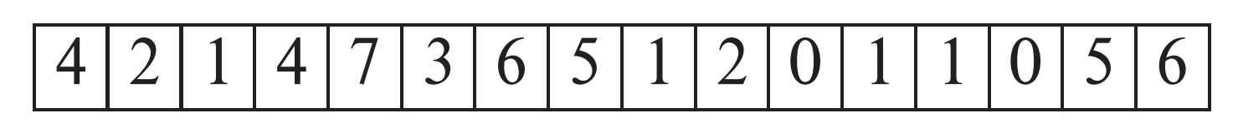
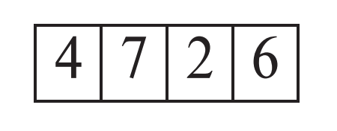
Heap File Organization
Records can be placed anywhere in the file where there is free space
Records usually do not move once allocated
Important to be able to efficiently find free space within file
Free-space map
  Array with 1 entry per block. Each entry is a few bits to a byte, and records fraction of block that is free
  In example below, 3 bits per block, value divided by 8 indicates fraction of block that is free
  Can have second-level free-space map
  In example below, each entry stores maximum from 4 entries of first-level free-space map
Free space map written to disk periodically, OK to have wrong (old) values for some entries (will be detected and fixed)

Slide 21
Sequential File Organization
Suitable for applications that require sequential processing of the entire file
The records in the file are ordered by a search-key

Slide 22
Sequential File Organization (Cont.)
Deletion – use pointer chains
Insertion –locate the position where the record is to be inserted
  if there is free space insert there
  if no free space, insert the record in an overflow block
  In either case, pointer chain must be updated
Need to reorganize the file
from time to time to restore
sequential order

Slide 23
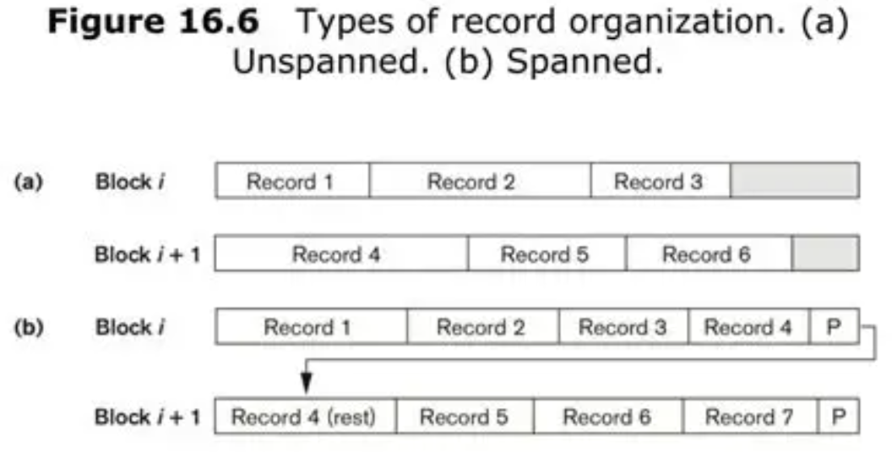
Unspanned Organization in Databases
In unspanned organization, a database record must fit entirely within a single database page.
If a record is too large for the current page's free space, it is placed entirely in a new, different page.
No record is ever split or fragmented across multiple pages.

Slide 24
Contrast: Spanned Organization
Spanned Organization allows a single record to be split across multiple pages if it doesn't fit in one.
This is more space-efficient but adds complexity, as the DBMS must manage pointers to all the record's fragments.
Conclusion: Unspanned organization prioritizes read performance and simplicity at the cost of potential space inefficiency. It is the most common default for storing regular table data.

Slide 25
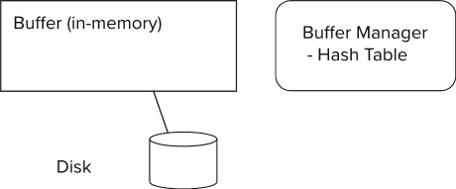
Storage Access
Blocks are units of both storage allocation and data transfer.
Database system seeks to minimize the number of block transfers between the disk and memory. We can reduce the number of disk accesses by keeping as many blocks as possible in main memory.
Buffer – portion of main memory available to store copies of disk blocks.
Buffer manager – subsystem responsible for allocating buffer space in main memory.

Slide 26
Buffer Manager
Programs call on the buffer manager when they need a block from disk.
  If the block is already in the buffer, buffer manager returns the address of the block in main memory
  If the block is not in the buffer, the buffer manager
    Allocates space in the buffer for the block
      Replacing (throwing out) some other block, if required, to make space for the new block.
      Replaced block written back to disk only if it was modified since the most recent time that it was written to/fetched from the disk.
    Reads the block from the disk to the buffer, and returns the address of the block in main memory to requester.

Slide 27

Cache Policy
CPU
Cache
Memory
A Policy needs to be defined to keep the access to Memory in the cache as much as possible
m：cache miss rate
T_{m}: memory access time
T_{h}: cache access time
→ the lower m the better

Slide 28
First In First Out (FIFO)
Data Addr.
A | B | B | E | F | B | C | B | E
A | A | A | E | E | E | E | E | E
B | B | B | B | F | F | F | F | F
C | C | C | C | C | B | B | B | B
D | D | D | D | D | D | C | C | C
Missing rate = 4/9
Always replace the earliest entry in the cache
This part will be Lab 1

Slide 29
Least recently used (LRU)
Data Addr.
A | B | B | E | F | B | C | B | E
A(0) | A | A | A | A | A | C(7) | C | C
B(-3) | B(2) | B(3) | B | B | B(6) | B | B(8) | B
C(-2) | C | C | E(4) | E | E | E | E | E(9)
D(-1) | D | D | D | F(5) | F | F | F | F
Missing rate = 3/9
This strategy requires keeping a "date of birth" for cache lines and tracking the "least recently used" (oldest) cache line based on it
The difference between LRU and FIFO is that Processor's access to a record will update its "date of birth", while FIFO does not

Slide 30
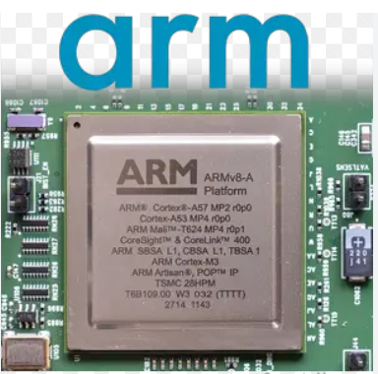
Random Replacement Policy
Steps:
  If the cache is not full, save the most recently accessed data in the cache
  If it is full, replace one of them at random.
  Simple and stable, once used in ARM processors

Slide 31
Other Policies
More policies can be found:
https://en.wikipedia.org/wiki/Cache_replacement_policies
Find or design a suitable policy for Q6 in CW2!

Slide 32
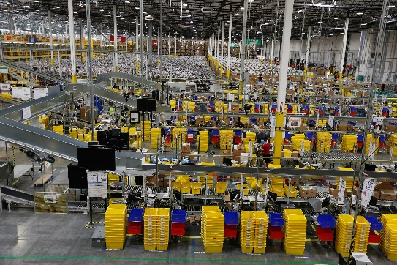
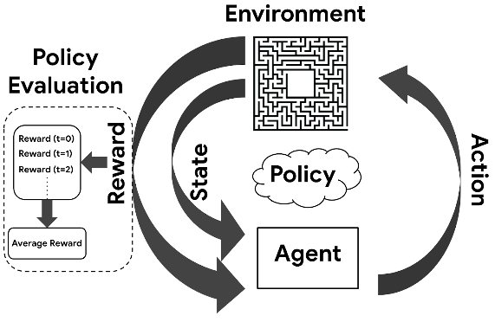
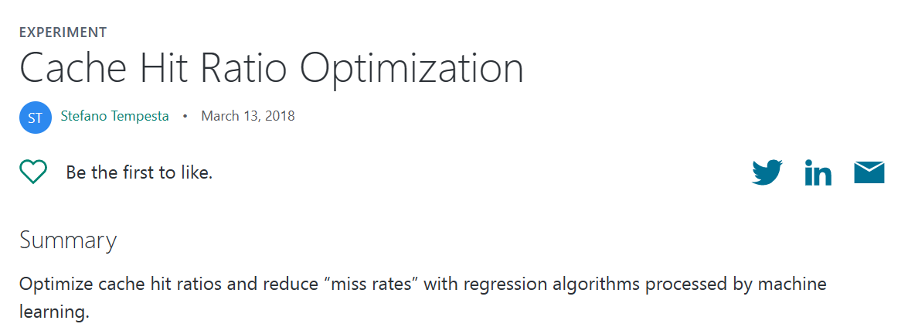
Further Reading*
Cache is everywhere
  Web Content
  Video Broadcast
  Logistic/warehousing
Can it be solved by ML? Yes.
Amazon Logistics
Policy in Reinforcement Learning

Slide 33
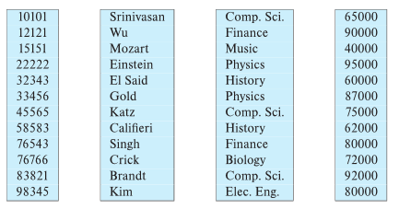
Column-Oriented Storage
Also known as columnar representation
Store each attribute of a relation separately
Example

Slide 34
Columnar Representation
Benefits:
  Reduced IO if only some attributes are accessed
  Improved CPU cache performance
  Improved compression
  Vector processing on modern CPU architectures
Drawbacks
  Cost of tuple reconstruction from columnar representation
  Cost of tuple deletion and update
  Cost of decompression
Columnar representation found to be more efficient for decision support than row-oriented representation
Traditional row-oriented representation preferable for transaction processing
Some databases support both representations
  Called hybrid row/column stores

Slide 35
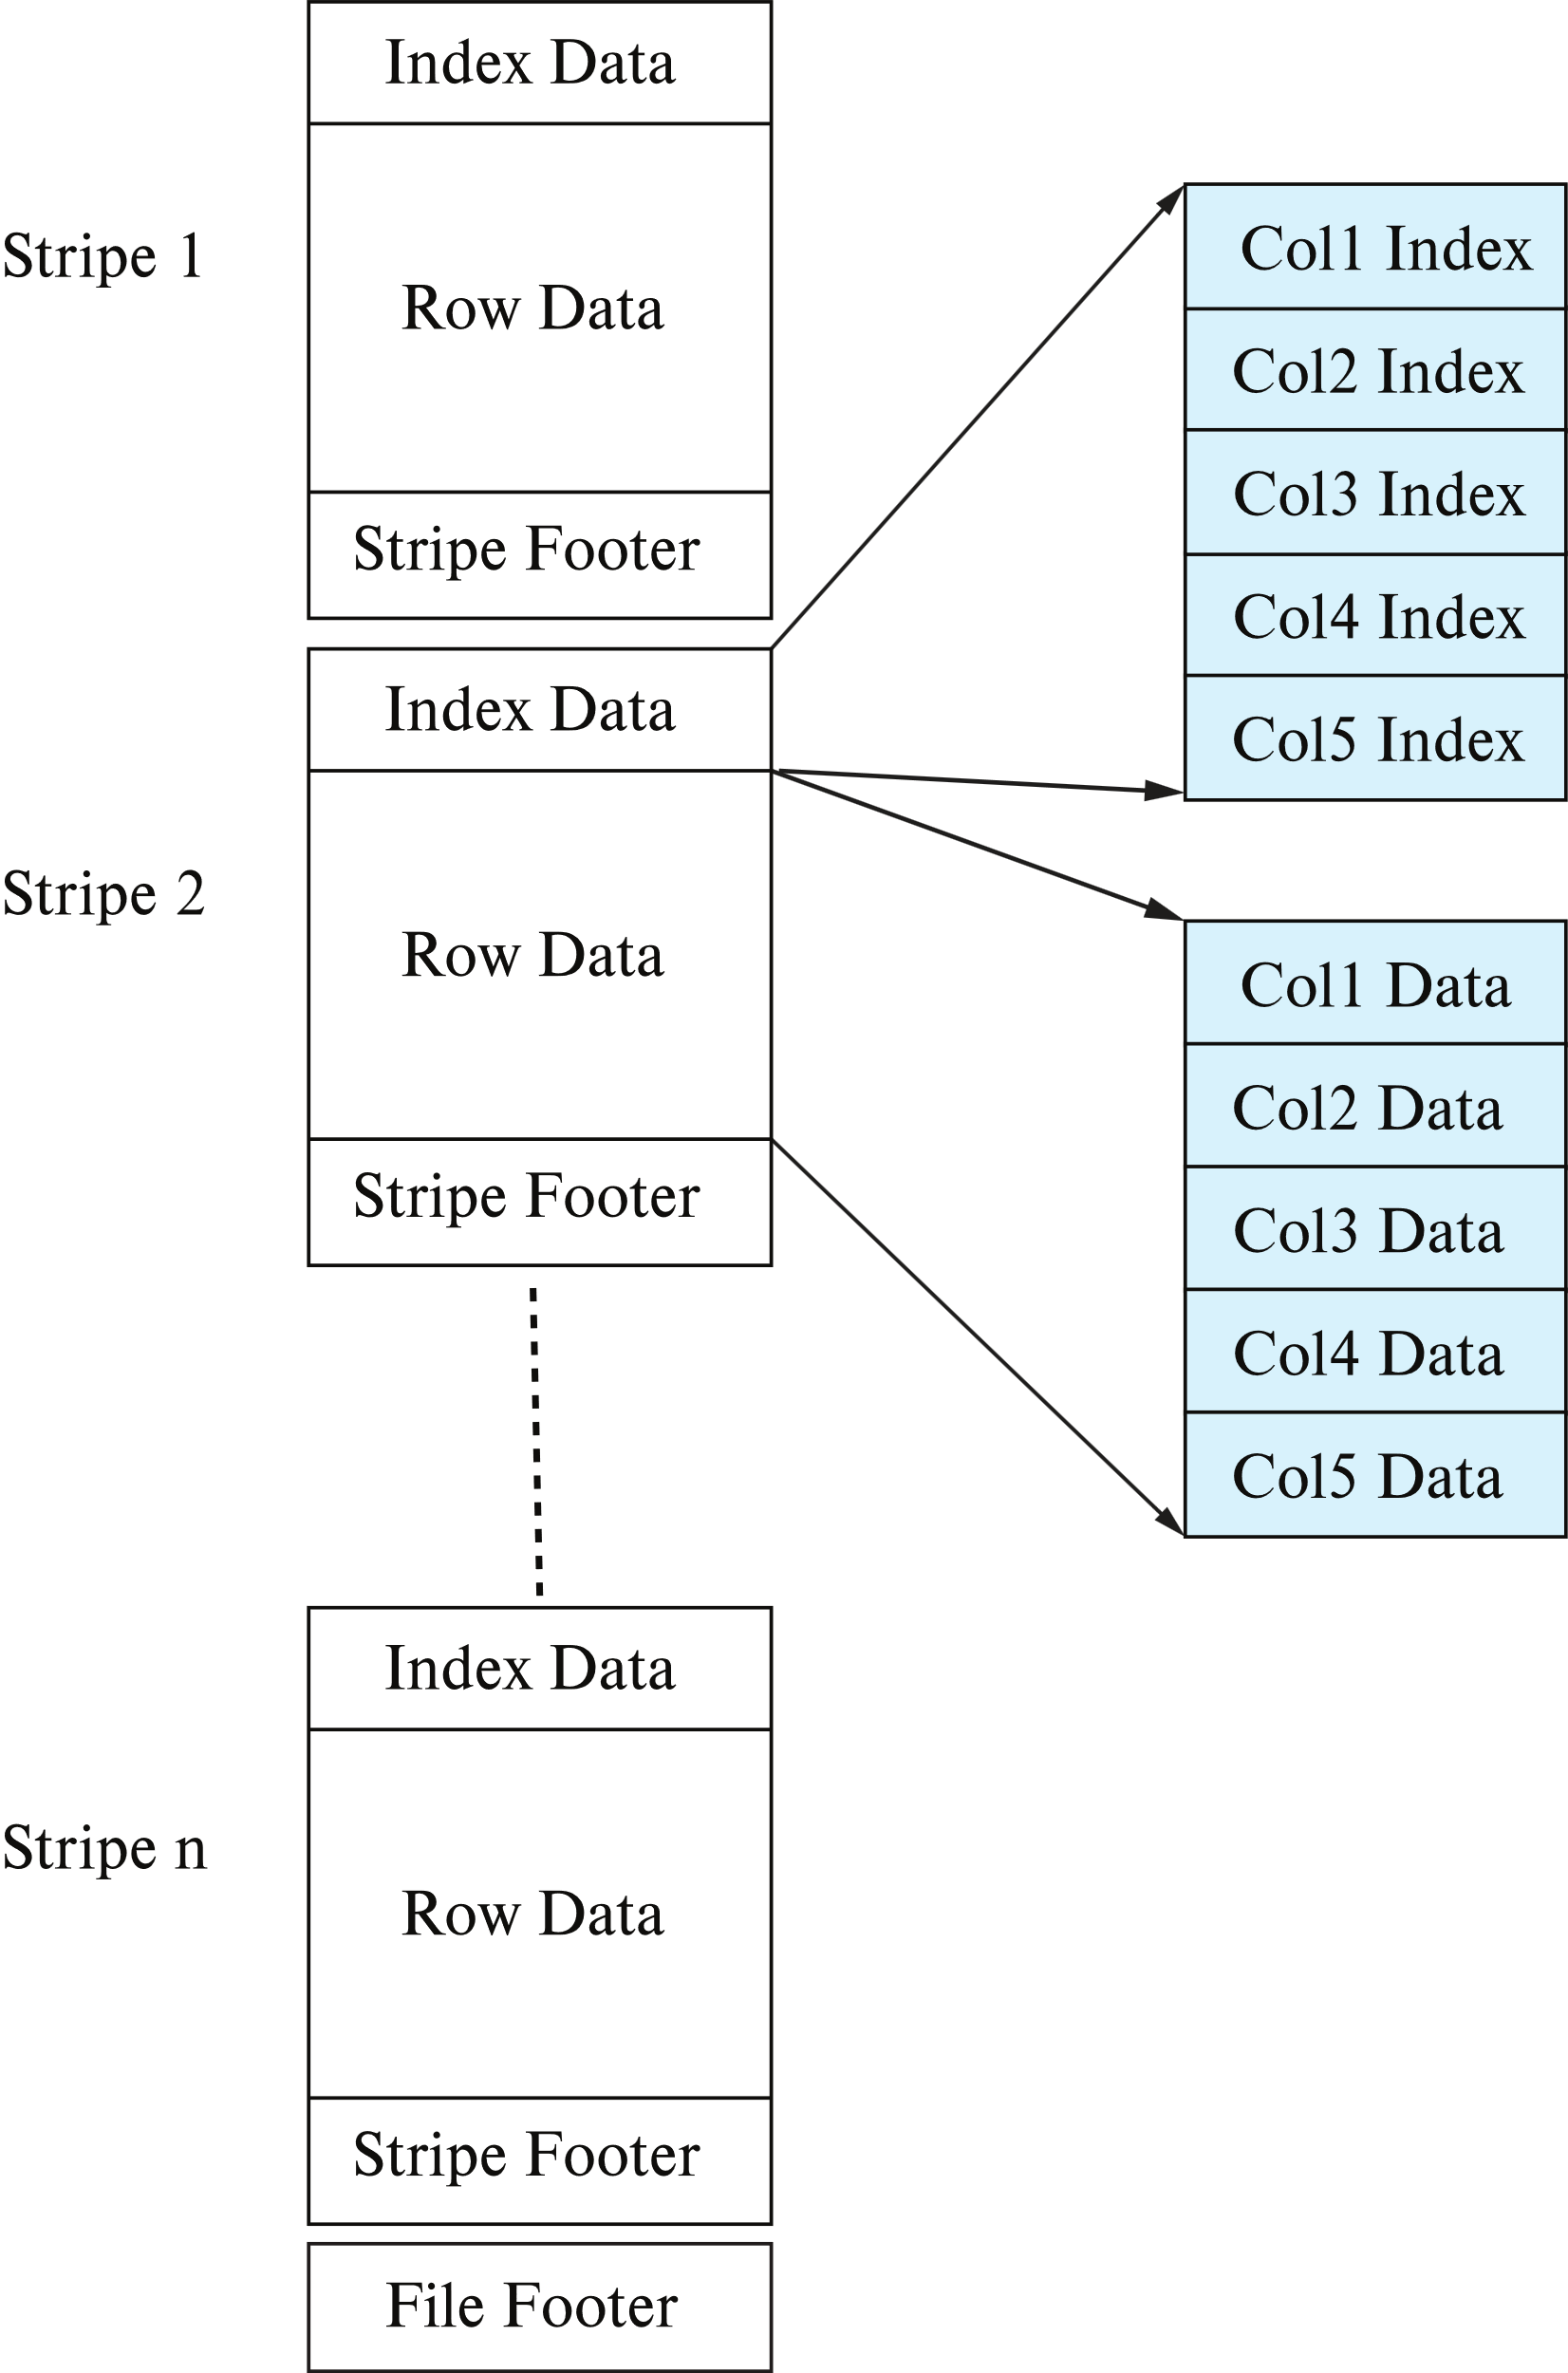
Columnar File Representation
ORC and Parquet: file formats with columnar storage inside file
Very popular for big-data applications
Orc file format shown on right:

Slide 36
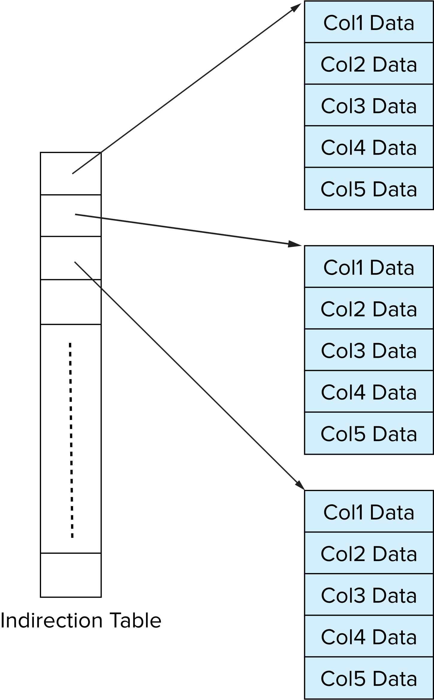
Storage Organization in Main-Memory Databases
Can store records directly in memory without a buffer manager
Column-oriented storage can be used in-memory for decision support applications
  Compression reduces memory requirement

Slide 37

Case
Notes:
https://en.wikipedia.org/wiki/Computer

